Slide 1

Basin Conservation: The Environmental Health of the San Marcos Watershed
Progress Report
BaCon Makes Everything Better!

Slide 2

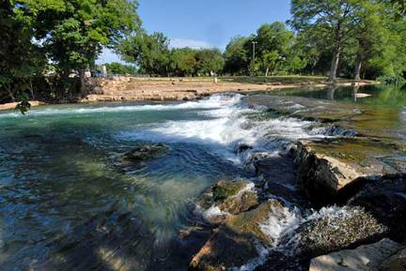
Contents
Background
Purpose
Scope
Schedule
Timeline
Data
LULC Maps
BASINS
Data Analysis
Final Deliverables
Conclusion

Slide 3
Background
Rapid growth of San Marcos
Increase in construction, impervious cover
  More runoff
  Less infiltration
  Non-point Source pollution
Concern for Health of the Upper San Marcos River Watershed
Goal is to maintain clean, clear water and prevent harm to native species and the human water uses.

Slide 4
Purpose
Assist in promoting an intelligent growth design for San Marcos while maintaining the pristine environment of the aquatic systems.
Use collected Data, Research Material, and Geospatial Technology
Study the impact of increased impervious cover in the Upper San Marcos River Watershed
End result will provide interactive maps via a website

Slide 5

Scope
All of the Upper San Marcos River Watershed going into the San Marcos River
  Spring Lake
  Until its confluence with the Blanco river
Western city development through the year 2035

Slide 6
Schedule
Data Acquisition went well.
Due to a slight issue during the BASINS training we have to extend the amount of time allotted for it.
Data Analysis should not take any longer however, so the date we should be done with it is the same.
The time set aside for web site development, final presentation, and other final deliverables should also remain the same.

Slide 7
Timeline
Calendars Include:
  Data Acquisition (Orange)
  BASINS training (Yellow)
  Data Analysis (Light Green)
  Web design and preparing the final presentation (Dark Green)
  Final Editing (Blue)

Slide 8
Data
Acquisition successfully completed
  Most downloaded directly through BASINS
  National Hydrography Dataset plus (NHDplus) from Meadows Center
  Water quality guidelines from Texas Commission on Environmental Quality (TCEQ)
  Spatial data from Texas General Land Office and Texas State University
  Land Use Data for City of San Marcos from the Meadows Center
  Research finished on the species of interest

Slide 9
LULC Maps
The land use and land cover data will be at the core of our project.
We decided to showcase the present and predicted LULC percentages in San Marcos in a couple of maps.

Slide 10
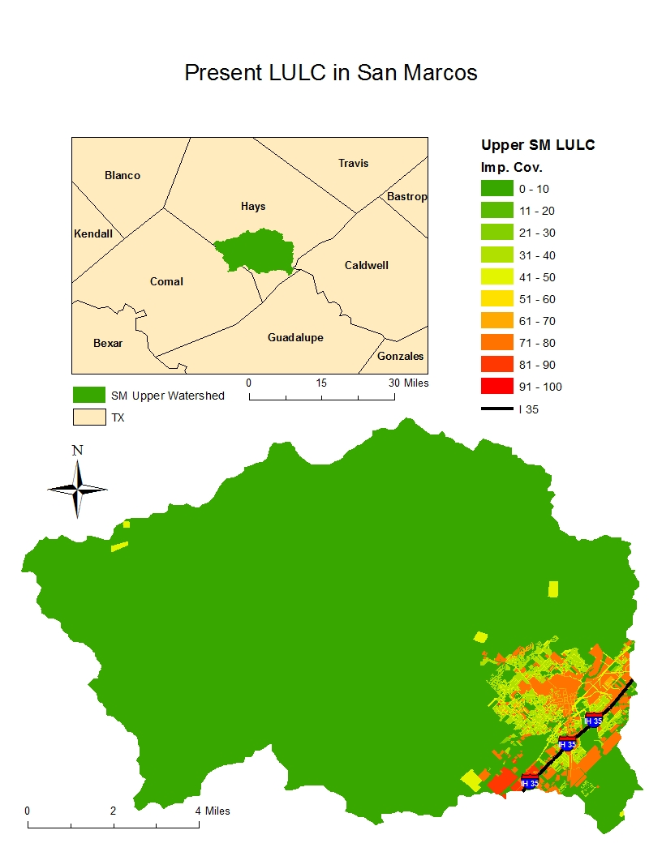

Slide 11
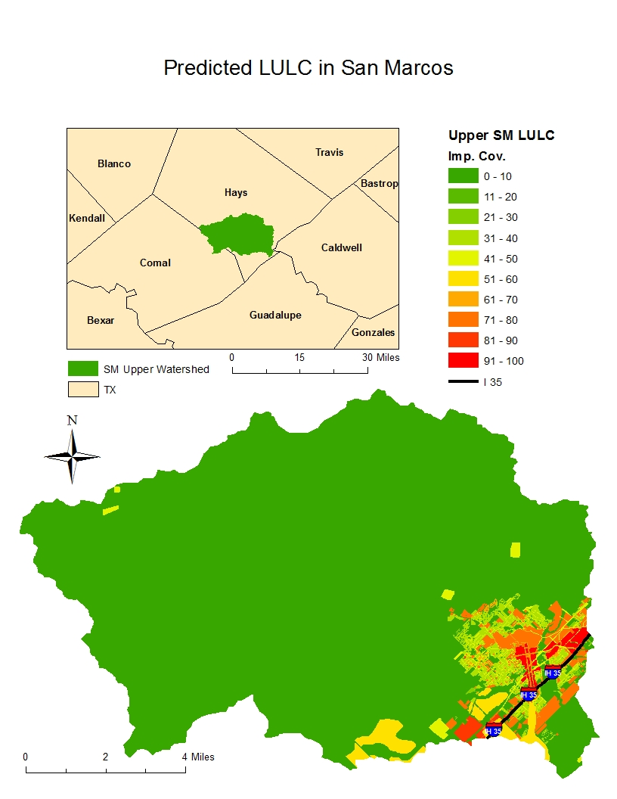

Slide 12
BASINS
Training
  Using a modeling Program
  Working with HSPF
National Hydrography Dataset Plus
  Issues
  Resolution

Slide 13
Data Analysis
Future Plans:
  Apply information to ensure acceptable water standards
    Want clean clear water
    Use endangered species research
  Will run all obtained data through BASINS HSPF model several times to obtain results.
  Will compare of current to potential impervious cover for San Marcos 2035
  Will assess the of environmental impact

Slide 14
Final Deliverables
Future Plans:
  Website with Interactive Capabilities
    Dreamweaver
  Detailed Final Report
  Poster
  CD with the above listed Data, Instruction File, and Readme File
  Hard Copies of Significant Maps

Slide 15
Conclusion
Mostly on Schedule, made slight extension for BASINS training
All data has been acquired as planned
Changes in endangered species
Future work through Basins, Arc Map, and data analysis
Success through hard work, communication, determination, and cooperation

Slide 16


